Slide 1












Idea In Brief: Automatic Chimney for Indoors with Activated Carbon filter
Team Member's Names: K.Sriram, S.Santhoshkumar, V.Rijutesh.
Chinmaya Vidyalaya
Srimathi Lingammal Ramaraju Matriculation Higher Secondary School, Rajapalayam.
Our Partners
(This is the property of Youth Ideathon 2022. This video file represents the video pitch of the team which made it to top 1000 teams)
www.youthideathon.in

Slide 2

Inhaling the cooking smoke is being associated with occurrence of respiratory infections, chronic illness, coronary heart diseases, cough and throat irritation. People with asthma and lung diseases are vulnerable to these kind of harmful toxic gases and smoke particles present in the air. We have developed a model which extracts Carbon monoxide gas (CO) which is present in the air and absorbs it using the activated carbon filter without emitting it into the environment.
The Problem Statement

Slide 3
The Proposed Solution - Your Idea
To solve this problem We have developed a prototype which automatically extracts the smoke particles, toxic gases like carbon monoxide, chemicals and Volatile organic compounds (VOCs) from air. It uses MQ-7 gas sensor ,exhaust fan and activated carbon filter which absorbs the exhausted smoke without emitting into the environment.

Slide 4
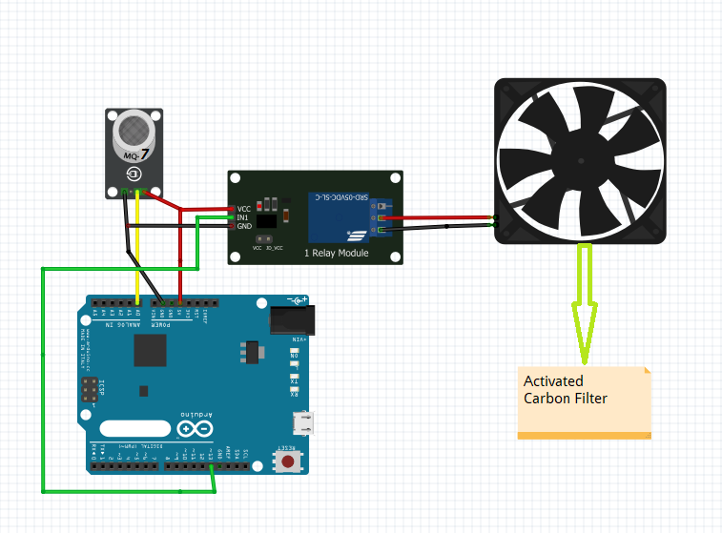
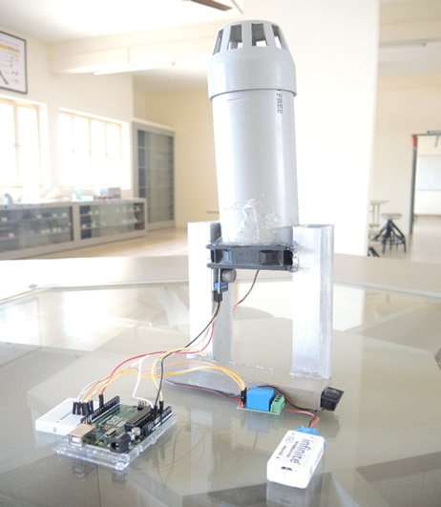
How my solution / idea works?
(The working model / design)
Circuit Diagram Designed model

Slide 5
What makes my idea great?
Smoke contains several hazardous chemicals, including carbon monoxide (also called CO), a gas that is especially toxic and dangerous.
The burning of biomass is associated with high levels of indoor air pollution and is considered as a major health concern in the developing countries, with an estimated two million people a year dying prematurely from illness attributable to indoor air pollution from solid fuels. Among these deaths, 44% are due to pneumonia, 54% from chronic obstructive pulmonary disease (COPD), and 2% from lung cancer.
Since our model prevents people from inhaling toxic gases and exposure to the pollutants, it can be a great solution to deploy in places like home & hotels kitchen, Industries where cooking smokes and other toxic gases released into the air.

Slide 6
THANK YOU FOR WATCHING
Please Like, Share & Comment to support this idea!
Our Partners
(This is the property of Youth Ideathon 2022. This video file represents the video pitch of the team which made it to top 1000 teams)
www.youthideathon.in

